Slide 1


Slide 2
Project 1
An Analysis of GCSE Examination Results in England
By
Mohammed Nawaz
Elcin Imanci
Yuk Hang Hui
Kashfi Khalid
Muse Amin
Adel Mahmud

Slide 3
Research Questions
How do gender, ethnicity and social class affect GCSE outcomes?
Is there a gender difference in the subjects that students take for their GCSEs?
Does the type of school attended affect GCSE outcomes?
Does geography affect students GCSE outcomes?
Was there a difference in GCSE outcomes between state and independent schools during COVID?
Are some subjects easier to get a Grade 9 in than others?

Slide 4
The data was obtained from:
https://www.gov.uk/government/collections/statistics-gcses-key-stage-4
Data files
Guidance

Slide 5
Before we start ……

Slide 6
Attainment 8
The average measure of an individual student’s progress across their 8 best performing subjects which fall into three buckets.
Progress 8
This is a measure of students’ progress across 8 subjects. This is a value added measure whereby students’ results are compared to students who had the same prior attainment score at KS2. It uses the same buckets as Attainment 8.

Slide 7
Buckets
Bucket 1: English and Maths
The score for Maths and English will be double weighted.
Bucket 2: Three highest Ebacc subjects, which are as follows:
• Separate Sciences
• Core & Additional Sciences
• Computer Science
• History
• Geography
• Languages
Bucket 3: Three ‘other’ subjects in which students have received their highest grades.

Slide 8
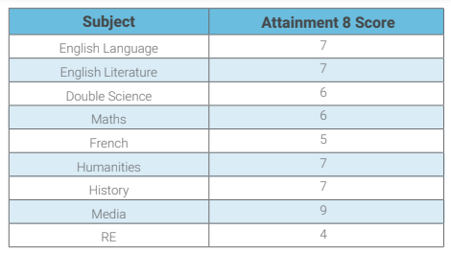
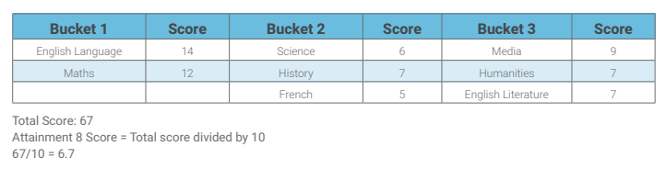
Amy achieved the following grades in her examinations:
GCSEs are graded from 1 to 9

Slide 9
Calculating a student’s Progress 8 score
Amy’s Attainment 8 score = 67
Amy’s estimated Attainment 8 score = 59.95
Progress 8 score = (67 – 59.95) / 10 = 0.71

Slide 10
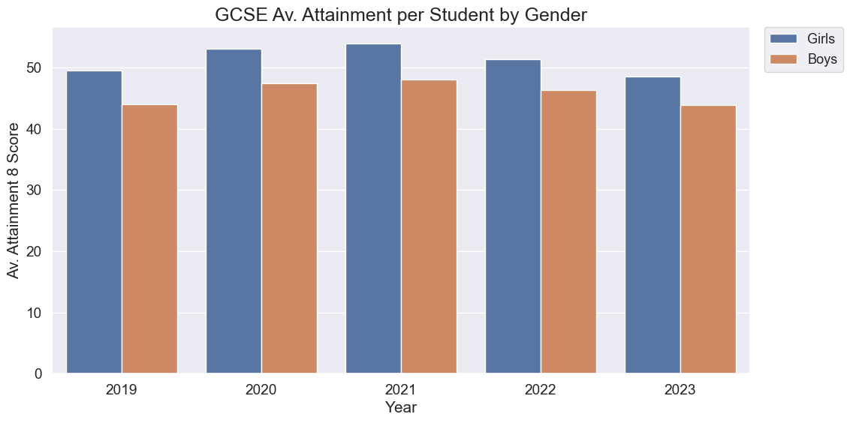
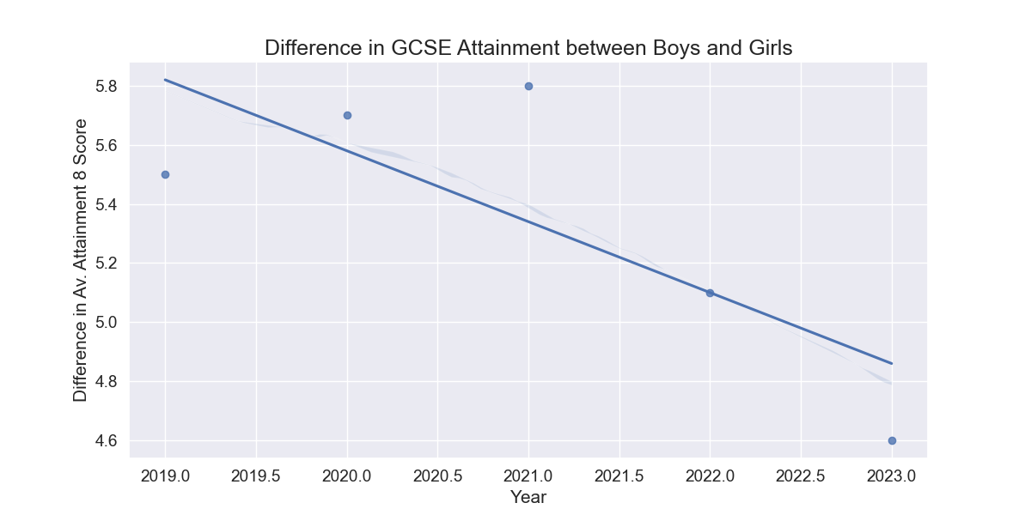
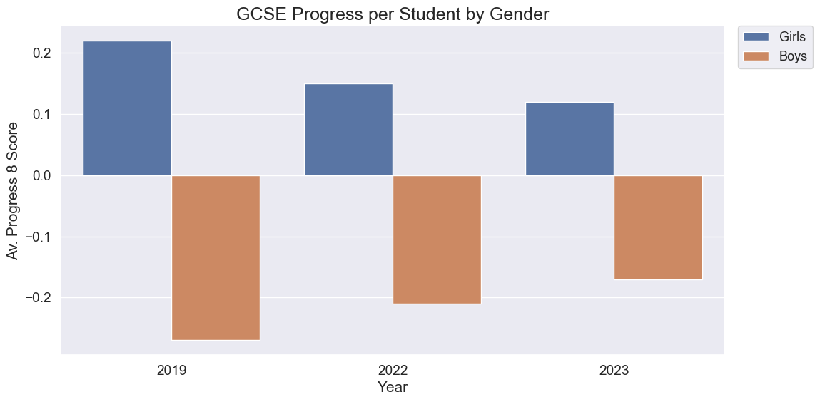
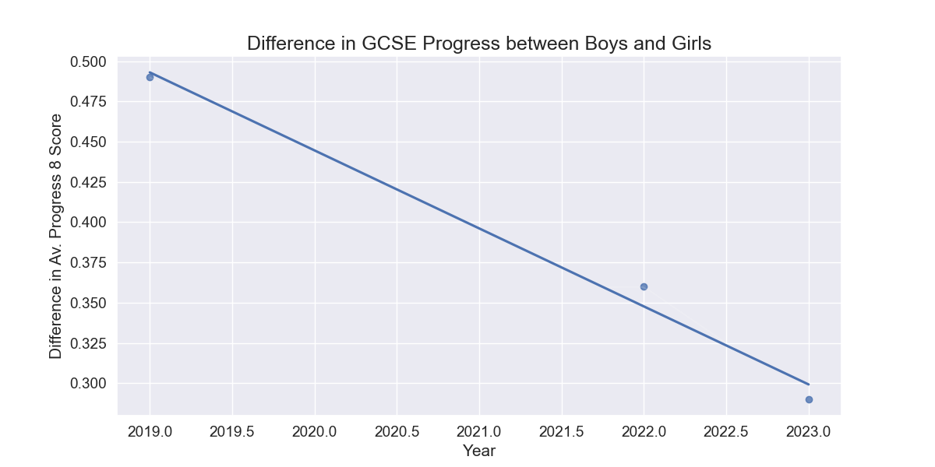
Gender Analysis

Slide 11
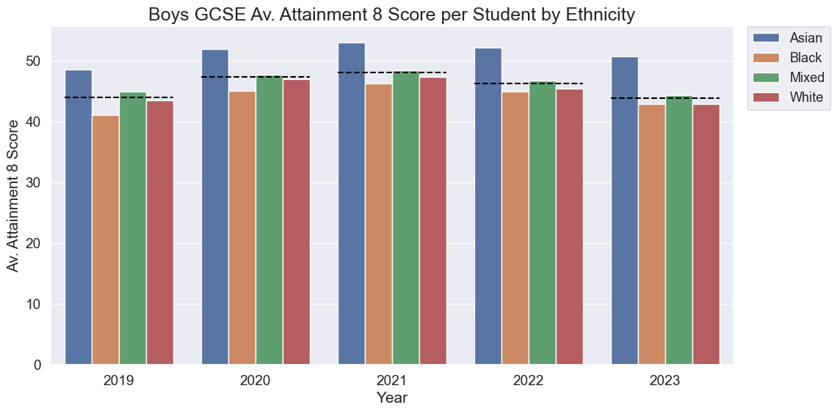
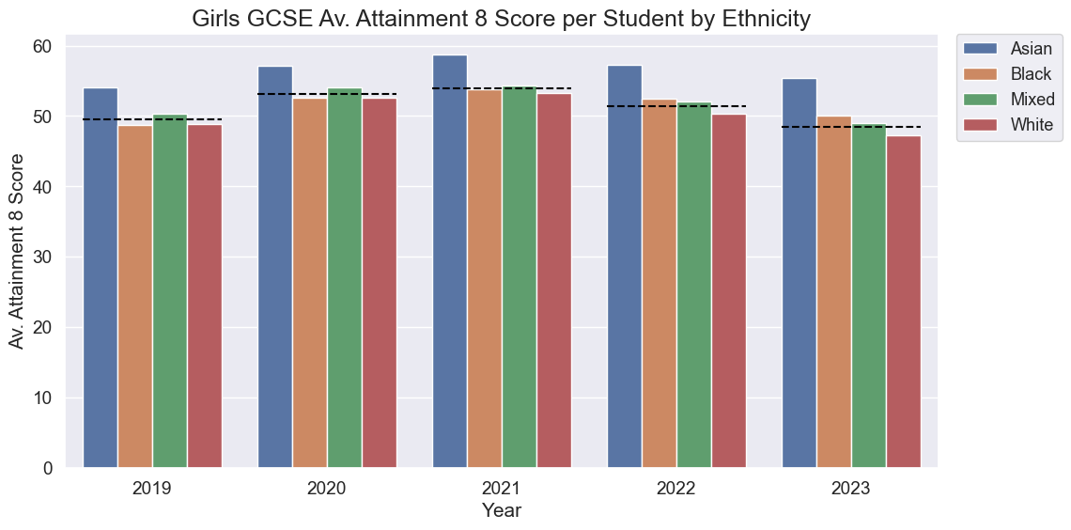
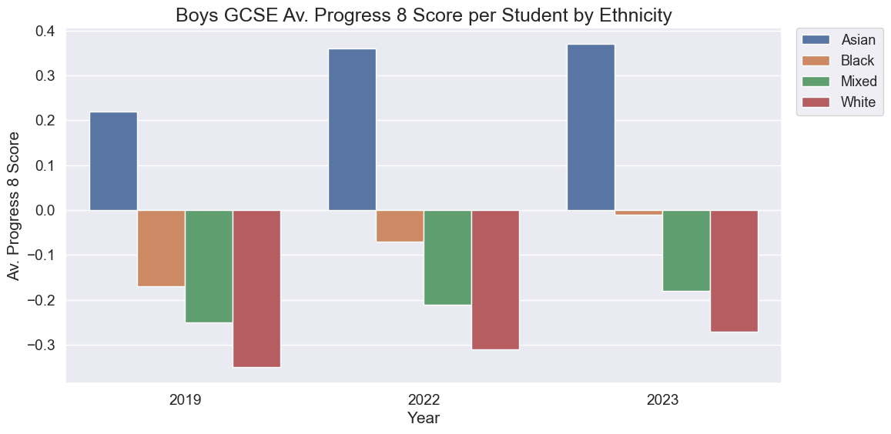
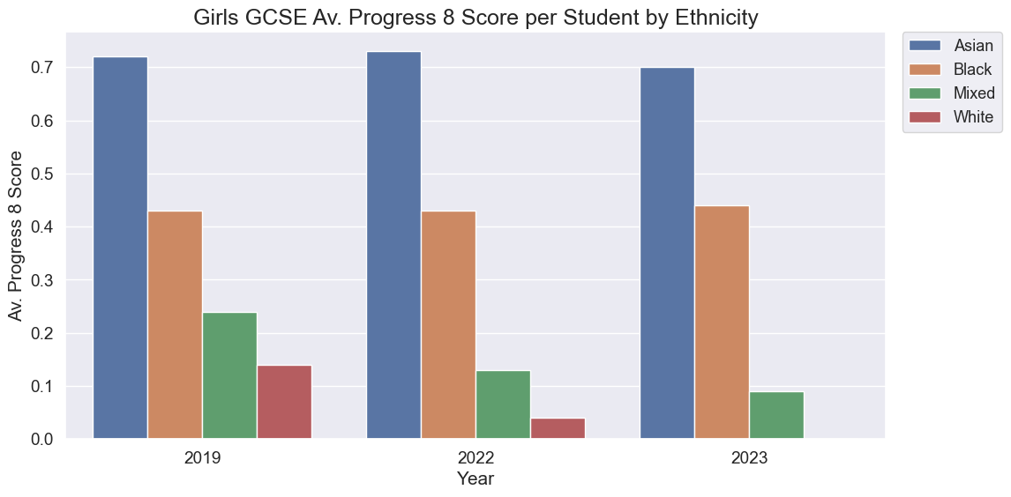
Ethnicity Analysis

Slide 12
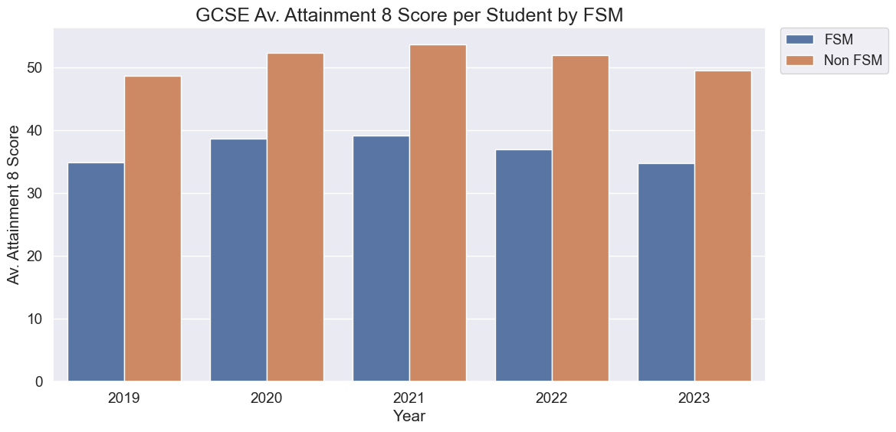
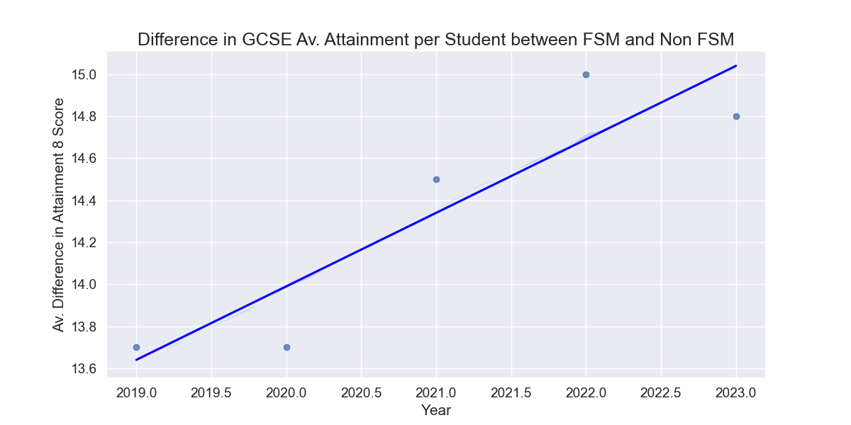
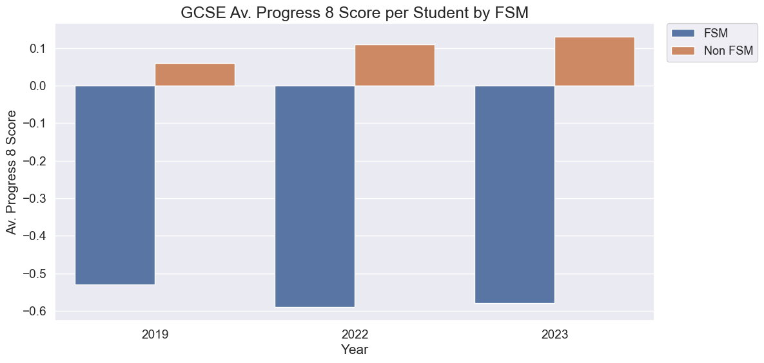
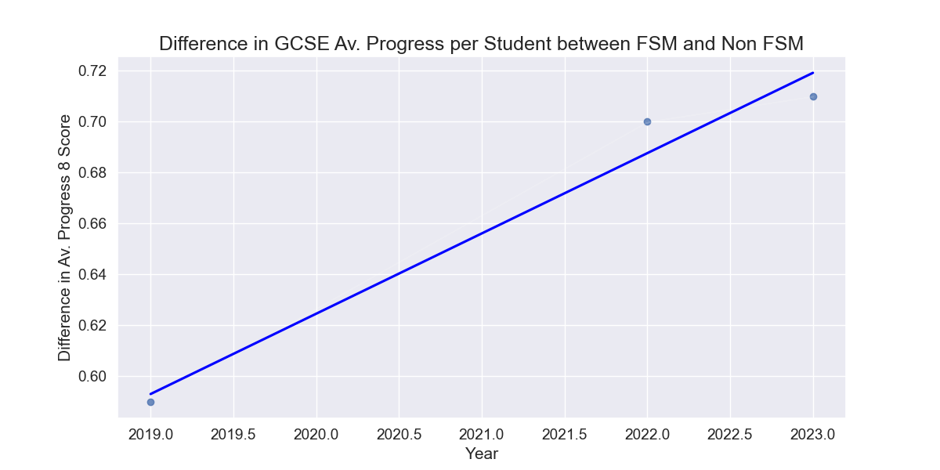
Social Class Analysis

Slide 13
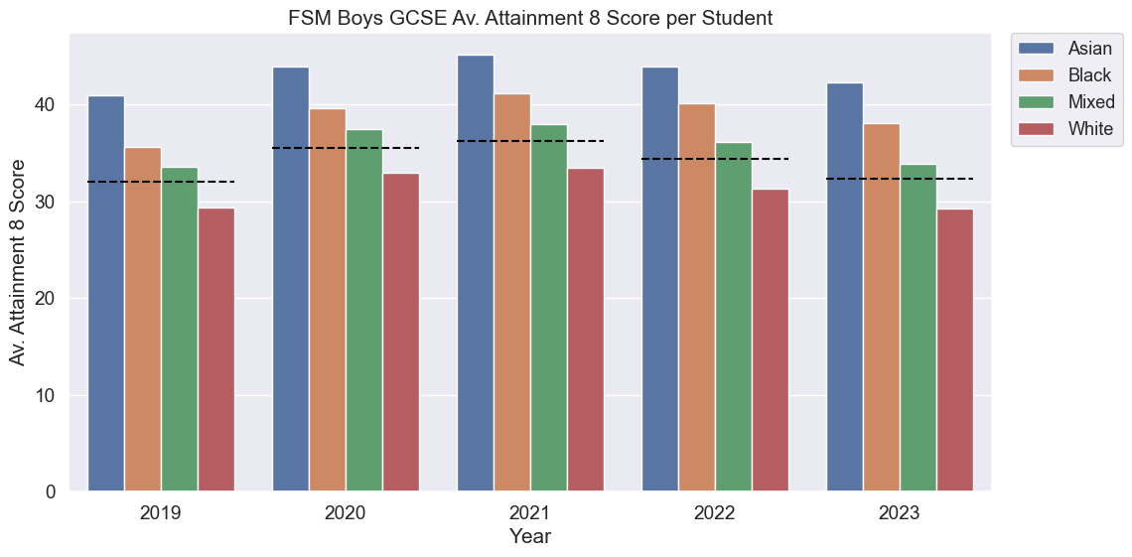
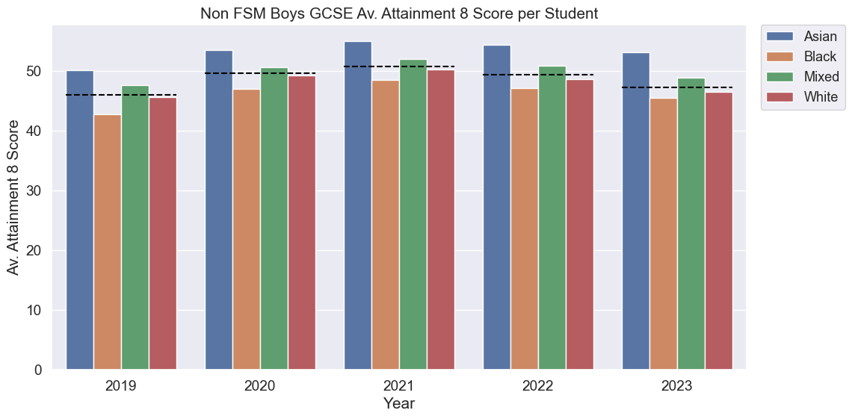
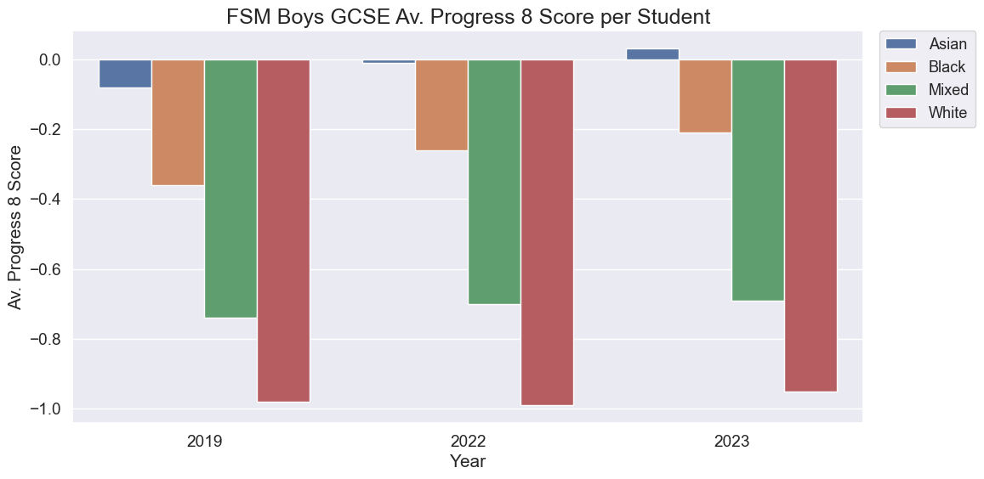
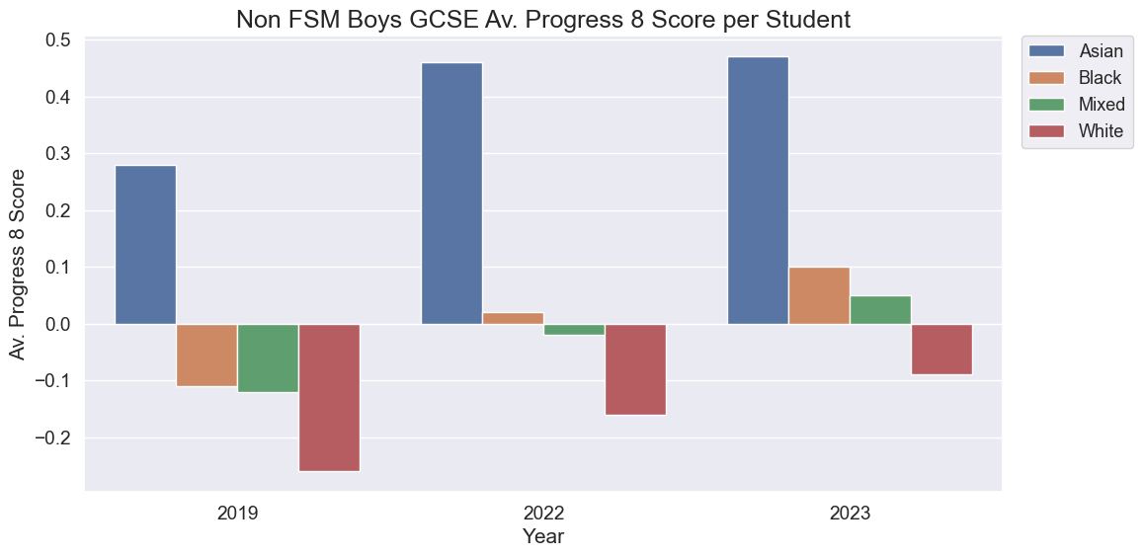
Social Class and Ethnicity Analysis

Slide 14
